Slide 1
Innovative Projects- Arduino Using Embedded ‘C’ (CSE1002) Phase –II Review Presentation (29th April 2023) IOT BASED VENTILATOR
Submitted to the Presidency University, Bengaluru in partial fulfillment of the requirements for the Innovative Project- Arduino Using Embedded ‘C’
By
IPA-392
Under the supervision of Ms.Sudha Y
Department of Computer science and Engineering April , 2023
Name | Roll Number
Deepak R | 20221CAI10144
Mahindra L Shetty | 20221CAI0126
Sangeetha E | 20221CAI0132
Monisha M | 20221CSG0135
Gouse E Zama | 20221ECE0069
Varun | 20221CSD0096

Slide 2
Project Brief Summery
OWERVIEW: Positive pressure ventilation has been an important components of respiratory disease management for the last 50 years. External instruments called ventilators are intended to provide artificial breath to a patient. In view of the covid 19 pandemic and its cause of respiratory distress. Low cost, portable, fast reproducible and accurate ventilators are the need of hour. So we as students have come up with a project called IOT BASED VENTILATOR in order to solve this problem.
OBJECTIVE: Devising a mechanical ventilator that has features like Portability, Simplicity, Fast reproducibility, Proximity, Robustness. To develop a health monitoring system i.e., it measures body temperature and heart rate. Power requirement is very low and running for 3.5 hours on one battery charge at its most demanding setting. Battery backup also need to be checked. Devising a mechanical ventilator that have controlled respiratory rate and tidal volume
OUTCOME: The ventilator serves to exhale gas (oxygen) into the patient’s lungs and helps strengthen the work of the respiratory muscles. This plays a vital role in emergency cases like COVID -19 where there was shortage in ventilatiors in those cases these ventilators can be used. (These are cheap, easy and very portable to use).

Slide 3
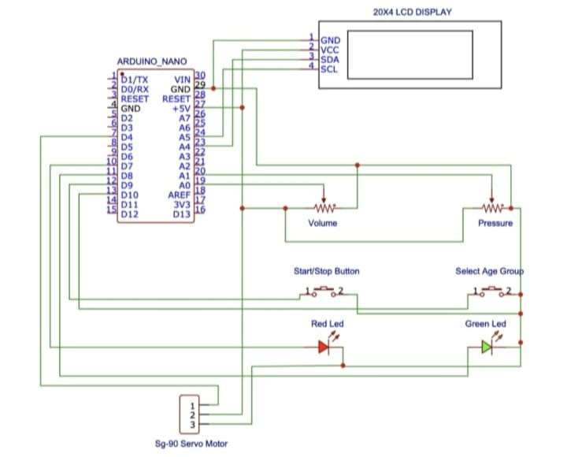
Circuit/Block Diagram

Slide 4
Obtained Results.
Include snapshot of the circuit built

Slide 5
Project Demo using tinker cad (Partial Results)

Slide 6
Challenges Faced in Project
IoT-based ventilators face several challenges, including:
•Security concerns: As with any IoT device, security is a significant concern. IoT-based ventilators need to be secure against hacking or unauthorized access to ensure patient safety and privacy.
•Reliability: IoT-based ventilators need to be reliable and maintain their functionality in all conditions, including power outages or network connectivity issues.
•Complex level of coding: The source code involved in this is a bit complex and rare libraries have been used
Time management: Including the electrical connections and coding the project requires a bit more time than the given deadline

Slide 7
Project Timeline
Note: Write in the below table what u have achieved in each phase and what you will be achieving before phase 3
Phase 1
Phase 2
Phase 3
Clearing up the obstacles
Examining the project setup numerous times
Concluding the fine project
Project estimation
Research on required components and estimation
Source Code availability
Had discussions and exchange of ideas in the group
20% of the project work was done
Organizing the project using Arduino board and components
Customising and executing the code
Ambu bag was pressurized
70% of the project has been completed
Node MCU connections has been established

Slide 8
Q&A

Slide 9
Thank you !!

